Slide 1
Announcement correction
Please install nmap, apache2, openssh-server on admin
Please install apache2, nmap on admin, A, B

Slide 2
Lab 1: IoT Search Engine

Slide 3
Lab1 - Outline
Overview
Lab Tasks
Task 1: Finding IoT devices using Shodan
Task 2: Implementing your own IoT search engine using Nmap
Task 3: Blocking suspicious scans using Pfsense
Submission guideline

Slide 4
Overview
Many IoT devices are publicly accessible, perhaps due to misconfiguration
Unauthorized users can access such devices to steal private data (e.g., webcam feeds), manipulate data (e.g., traffic light signals), or even take control of the devices to attack others (e.g., DDoS bots)
Lab objectives:
Understand that proper isolation, access control, and authentication must be in place to protect IoT devices from unauthorized access
Learn how to identify/hide IoT devices are identified on the Internet

Slide 5
Task 1: Finding IoT devices using Shodan

Slide 6
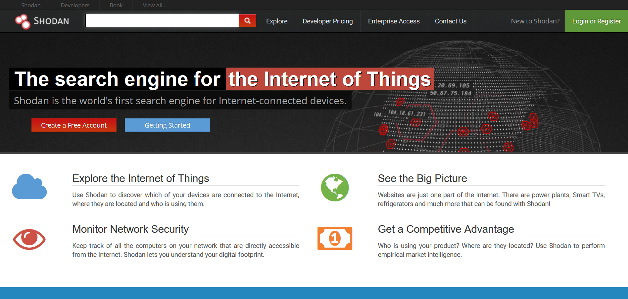
Shodan
An IOT Search Engine
Scan the whole internet once a month
Use filter to find specific device

Slide 7
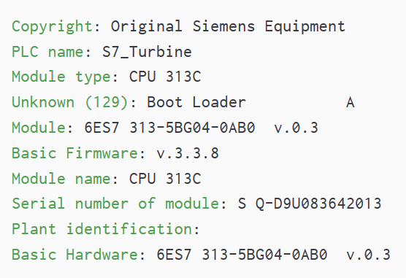
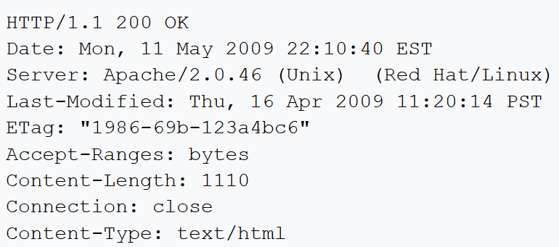
Service banners
Banner is some text message received from the host’s service.
By using banner grabbing, attacker can know the services running on specific computer.
HTTP banner
Siemens S7 industrial control system banner

Slide 8
Typical filters in Shodan
Typical Filter :
Org : EX: google
IP : EX: 140.112.xxx.xxx
Country : EX: TW, US
Net : EX: 140.112.0.0/16
Port : EX: 22, 80

Slide 9
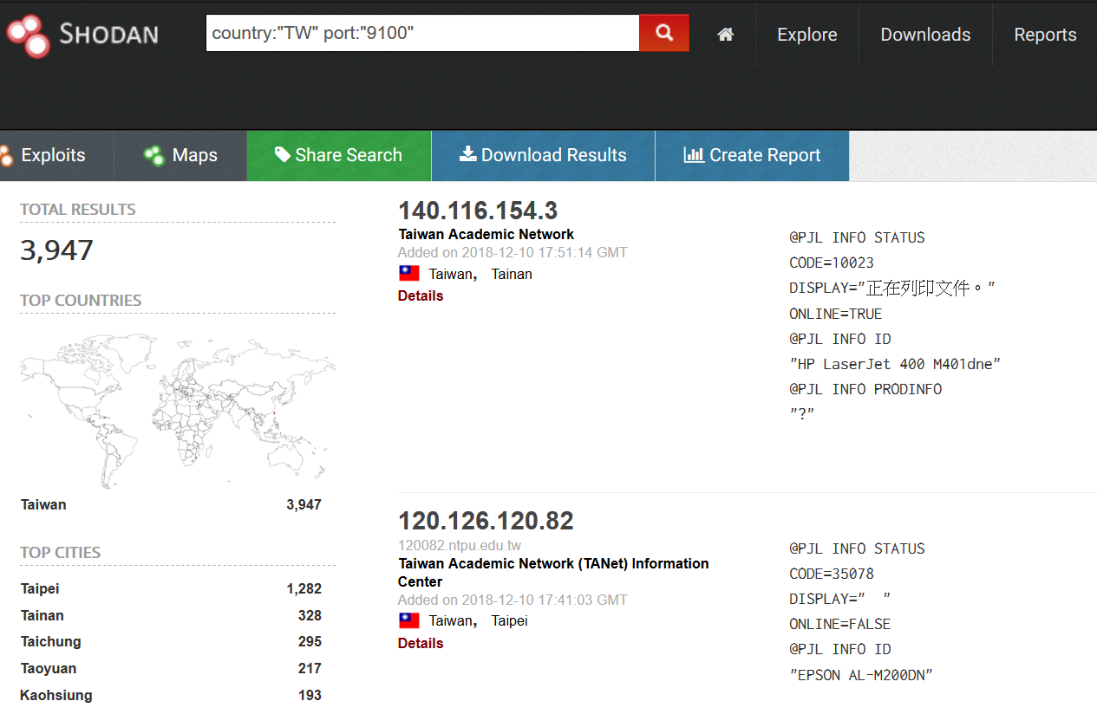
Shodan - Example

Slide 10
Try it!
Use Shodan to find devices and websites
IP/Net : 140.112.0.0/16
Country : Taiwan
Port : 80
Running : Http

Slide 11
Task 2: Implementing your own IoT search engine using Nmap

Slide 12
Nmap
A convenient port scanning tool.
The default Nmap scanning using TCP SYN packets will return the opening port and whether the specific IP is running services.
Can use NSE script to automatically execute commands.

Slide 13
Basic nmap command
Nmap [option] [IP, Host]
-T1 ~ - T5 : Faster, More Aggressive. Recommend : T3 ~ T4
-p : port number
-p U:53,111,137,T:21-25,80,139
-O: OS detection
…
-A : Apply multiple detection
-Pn : no ping
-sn : ping scan

Slide 14
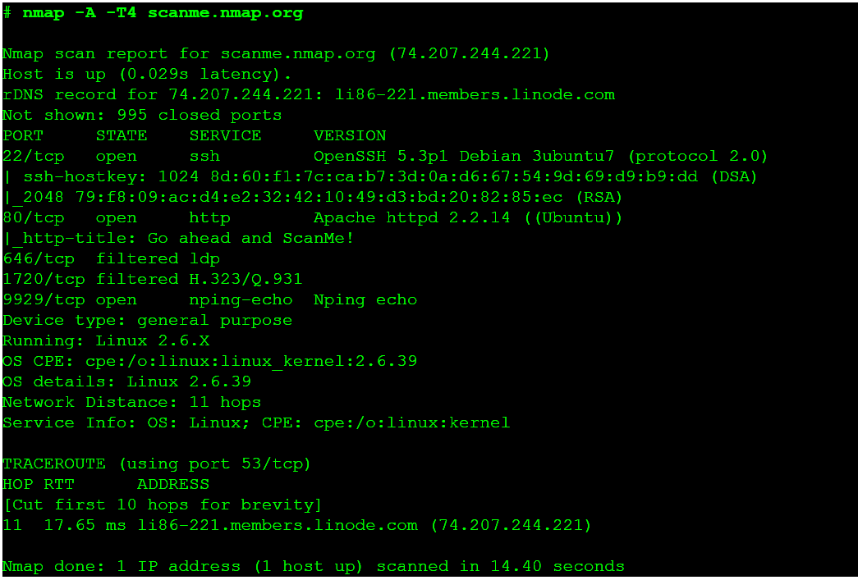
Search for CPE

Slide 15
Common Platform Enumeration (CPE)
The common ID for almost all products
Standard URI for:
Operating system
cpe:/o
Application
cpe:/a
Hardware Platform
cpe:/h

Slide 16
Common Platform Enumeration (CPE)
Example:
Application : google chrome:
cpe:/a:google:chrome:2.0.172
Operating system : linux kernel
cpe:/o:linux:kernel:2.6.11.4
Hardware Platform : gateway
cpe:/h:mcafee:web_gateway:7.0

Slide 17
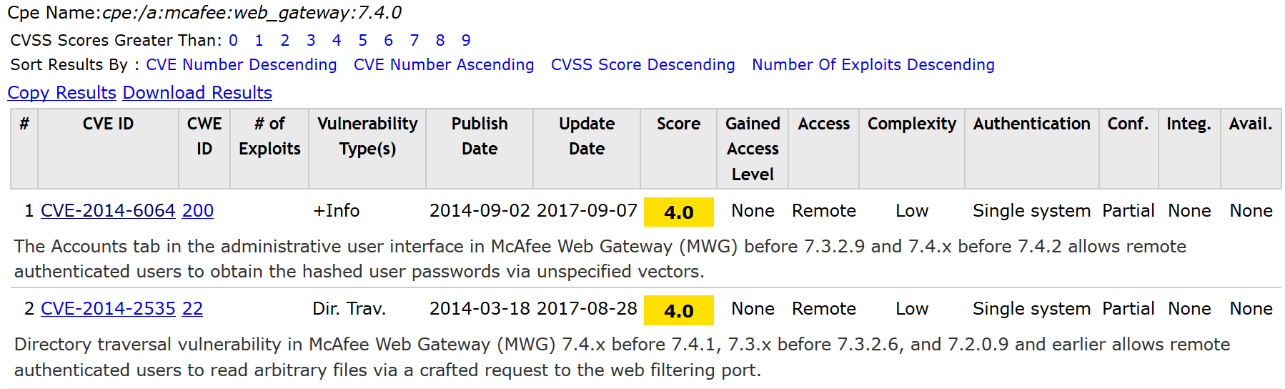
CVE and CPE

Slide 18
Task 3: Blocking suspicious scans using Pfsense

Slide 19
Blocking nmap
Nmap use normal protocols actions to check the service and host.
Hard to detect if nmap transfer reasonable traffic.
We should use firewall and whitelist to block nmap.

Slide 20
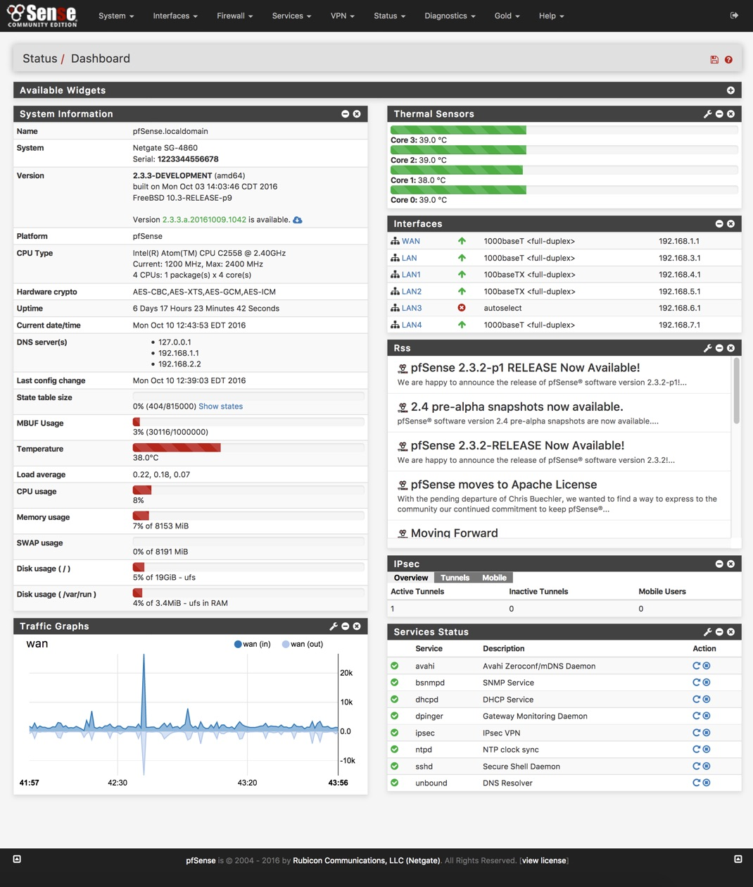
Pfsense
A open source firewall
Easy to set up and operate
A clear GUI interface

Slide 21
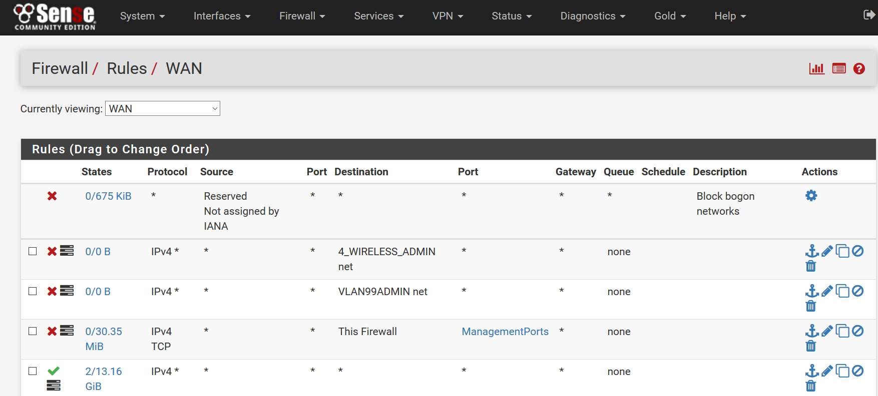
Pfsense - Rules
Pfsense can add rules on interfaces
The upper rules have higher priority
Default blocking
Higher Priority (Block what we want)
Lower priority(Let the rest pass)

Slide 22
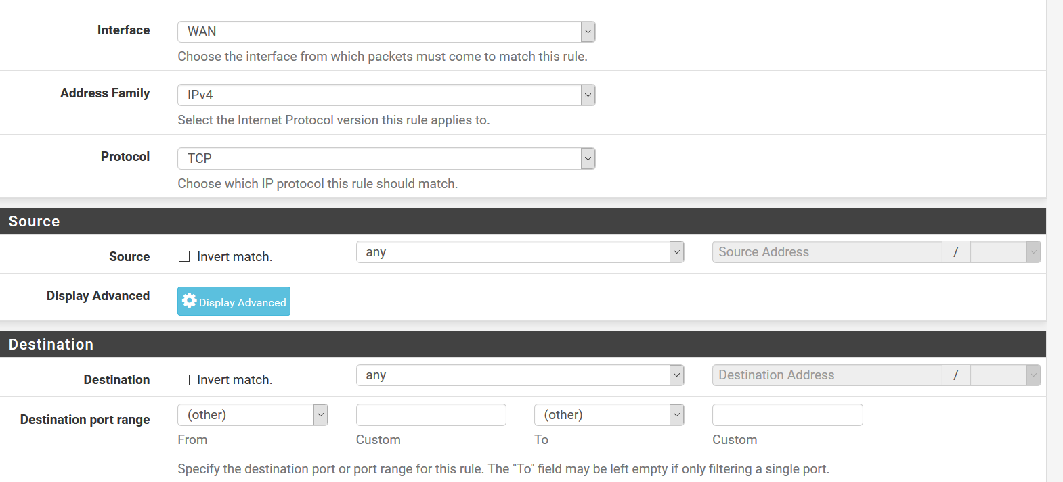
Pfsense - Rules
Can block/allow base on
Source
Destination IP
Port
Protocols

Slide 23


Pfsense – Lab
WAN
A
Admin
IP : 192.168.8.1/24
IP : 192.168.7.2/24
IP : 192.168.7.1/24
B
IP : 192.168.8.2/24
OPT1
LAN
IP : 192.168.7.3/24

Slide 24
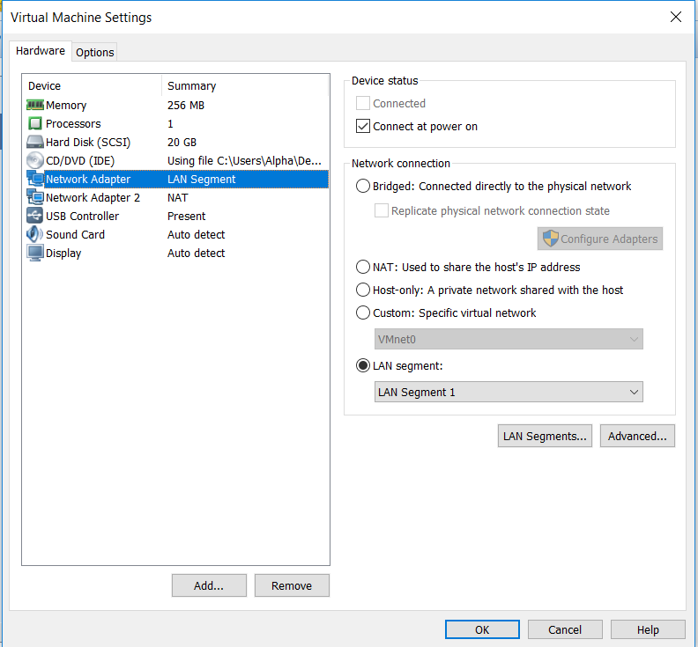
Pfsense – Virtual machine connection
Vmware :
Add network adapter and add a LAN segment to construct virtual local network between virtual machine
Virtualbox :
Also add interface and change it to LAN.

Slide 25
Pfsense – Interface Configure
Pfsense: 3 interface : NAT, LAN1, LAN2
Admin: 1 interface : LAN1
A, B: 1 interface : LAN2

Slide 26
Pfsense – DHCP
Full name : Dynamic Host Configuration Protocol
DHCP server will allocate IP address to dhcp client
For server side: Pfsense can open the dhcp server on Interface assignment
For client side:
ifconfig
dhclient interface

Slide 27
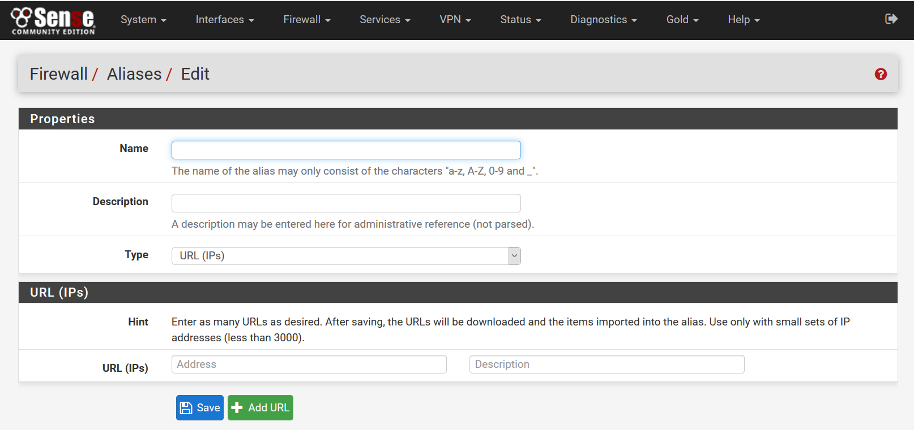
Pfsense - Alias
Group some IP into the same group
The IP list can be acquired from a url
Can let a website to authenticate the user, and add it into the pfsense’s white list.

Slide 28
Pfsense - Alias
To let pfsense access your webpage, you need to install apache web server.
Put your whitelist file in /var/www/html.

Slide 29
Submission Guideline

Slide 30
Lab(50%)
Please configure your firewall rules to satisfy each of the following requirements, and explain how you have achieved it:
Only Admin can nmap scan A, B, please show the nmap result to TA (20%)
A file should be placed in admin as whitelist, only IP in whitelist and Admin can access Pfsense Website (20%)
Everyone can ping each other (20%)
A, B can ssh to admin (20%)
Block everything not mention above (20%)
Demonstration deadline: 4/19
(16:00 ~ 17:00 Wed. or send email to seclab-ta@csie.ntu.edu.tw to make appointment)

Slide 31
Report(50%)
1. Please write your rules, and write down why should you set up those rules.(50%)
2. Please write down 3 cpe( OS, Application, hardware)
3. Please write down corresponding CVE for your cpe. ( 2 & 3 50%)
Report deadline: 4/21

